Slide 1

Reading
Year 2 – Theme 5 - Energie

Slide 2
The Novels
During the following weeks you are going to read an English novel. There are 3 novels:
Racing the Tide (more suitable for MAVO; A1/A2 - 2a)
Road to Nowhere (more suitable for HAVO; A2 - 2b)
The Creature (more suitable for VWO; A2 - 3a)
All three books are at the A2 level, so all stories are at the appropriate level for year 2.
Yet, language-wise Racing the Tide might be easier and therefore more suitable for MAVO, Road to Nowhere is bit more difficult, and The Creature is the most challenging and therefore most suitable for VWO.

Slide 3
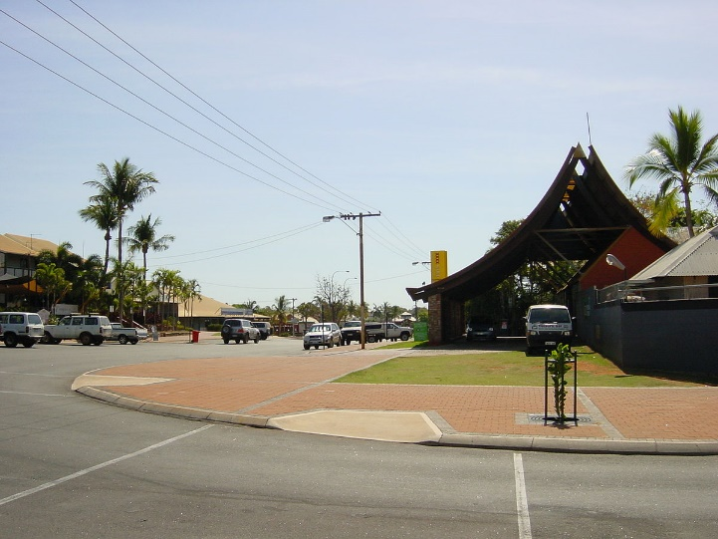
Racing the Tide
Ella and her family live in a trailer park in Broome, Australia. Ella doesn’t like living there and doesn’t spend a lot of time there. She finds the tides and the people very weird; then there’s also the story of a schoolgirl who went missing. When Ella stumbles upon the braceclet, she thinks she knows what has happened to Jenny...

Slide 4
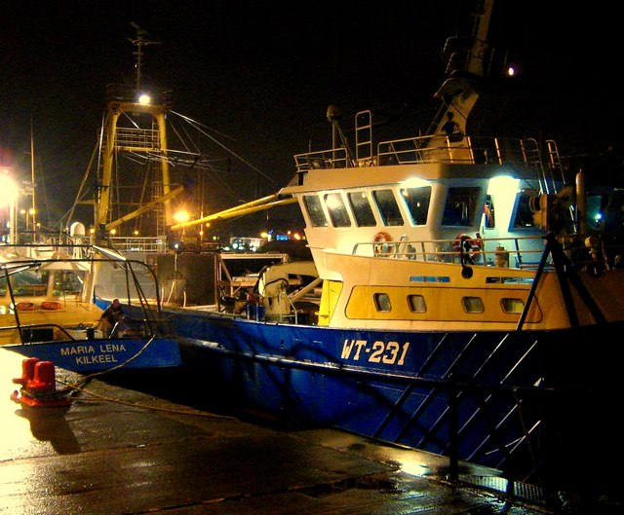
Road to Nowhere
One night, Nick sees some strange things happening at the beach near his family’s farm. There are people getting off a boat; he suspects they are illegal immigrants. When he investigates the situation, he realises he’s right. Soon he gets involved with a brother and sister and their attempt to escape from a people smuggler…

Slide 5
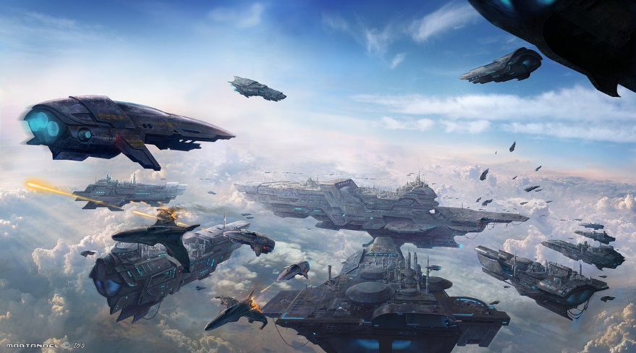
The Creature
Kin Zen is a 15-year-old boy who has already visited more of the galaxy and seen more planets than most people ever would. Both of his parents are scientists and together with thousands of people they are exploring the galaxy.
During their journey through outer space, they discover an alien creature. But this creature is unlike any of the other aliens they’ve collected so far. Everyone on board of the ship is starting to feel ill and it soon becomes clear this creature has powers beyond those of any human being…

Slide 6
Elements of a story - Questions
The general questions about the elements of the story are:
Who is the protagonist of the story? Why? (mavo-havo-vwo)
Describe the appearance and personality of the protagonist. (mavo-havo-vwo)
What is the setting of the story? Name both time and place. (mavo-havo-vwo)
Name at least 1 theme of the story and explain why/how you know this is a theme of the story. (havo-vwo)

Slide 7
Elements of a story - THEME
Theme = what the author is trying to tell/teach us with his/her story.
There can be more than one theme!
Themes are underlying subjects/statements/opnions of the novel.
Questions that help you determine the themes:
What happened?
What were the conflicts/problems?
What was the most important moment of the novel?

Slide 8
Elements of a story - SETTING
Setting = time and place
Questions that help you determine the setting:
When does the story occur (year, historical events, etc.)
Where does it occur?
Why is the main character presented in this setting?
How does the setting affect the main character?
How does the setting help create conflict/complications?
How does the setting influence the actions of the characters?

Slide 9
Elements of a story - CHARACTERS
Protagonist = main character or the story.
The protagonist is the character which the novel revolves around and the character you usually identify most with throughout the entire story.
The protagonist usually changes throughout the story by learning something new or by changing his/her view on something.
The author develops the characters in several ways:
By telling us directly about the character.
Having them think/speak/act in a particular way.
Interactions between your character and other characters in the story; as well as other characters’ opinions of them.

